Slide 1
Fascinating facts about gaucher disease
The history of Gaucher research, treatments and support

Slide 2
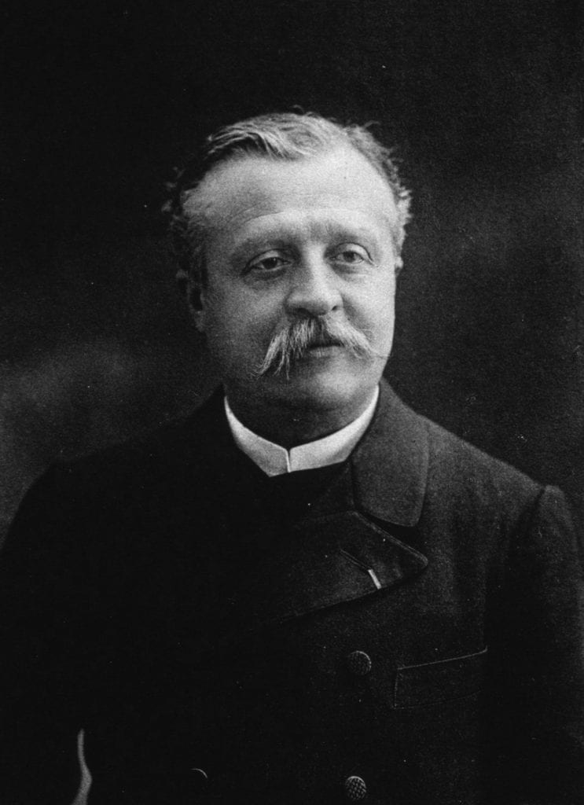
Dr. phillipe Charles Ernest Gaucher discovers Gaucher disease in 1882
Dr. Gaucher was a French dermatologist who, in his medical school thesis, described the autopsy of a 32 year-old woman who had not only a greatly enlarged spleen, but the cells in the spleen were greatly enlarged as well.

Slide 3
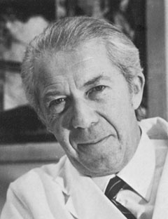
de duve accidentally discovers lysosomes in 1955
In 1955 Christian de Duve accidentally discovered a previously unknown organelle in the cell using fractionation technique. He called it the lysosome. The next year, it was seen by Novikoff through the electronic microscope.
For this and other discoveries in the cell, de Duve shared the 1974 Nobel Prize for Medicine.

Slide 4
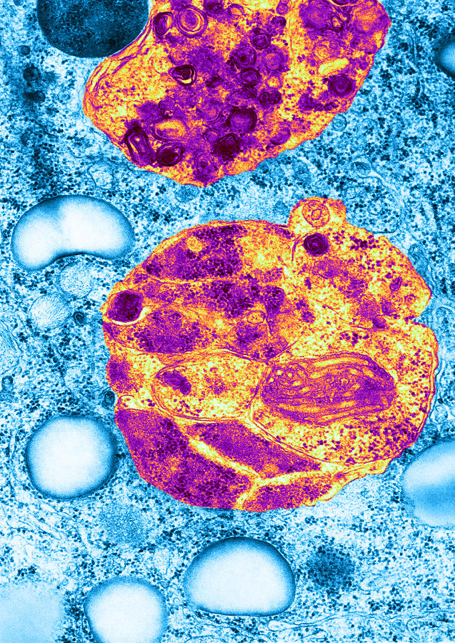
What are lysosomes?
Lysosomes are the recycling or digestive centers of the cells. They contain more than 60 enzymes and 50 membrane proteins. The enzymes break down old parts of the cell when they are dying. It is important that these parts are broken down to be excreted from the body. Otherwise, they will be stored in the cells, causing them to not work correctly.

Slide 5
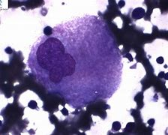
How Gaucher Disease is related to Lysosomes
Lysosomes contain enzymes that break down substances in the cells when they are no longer useful. Glucocerebrosidase is an enzyme that breaks down glucocerebroside, a fatty substance in cell membranes.
In 1934, a French chemist, Henriette Aghion found that the fatty molecule that stored in the enlarged livers and spleens in Gaucher disease was glucocerebroside.

Slide 6
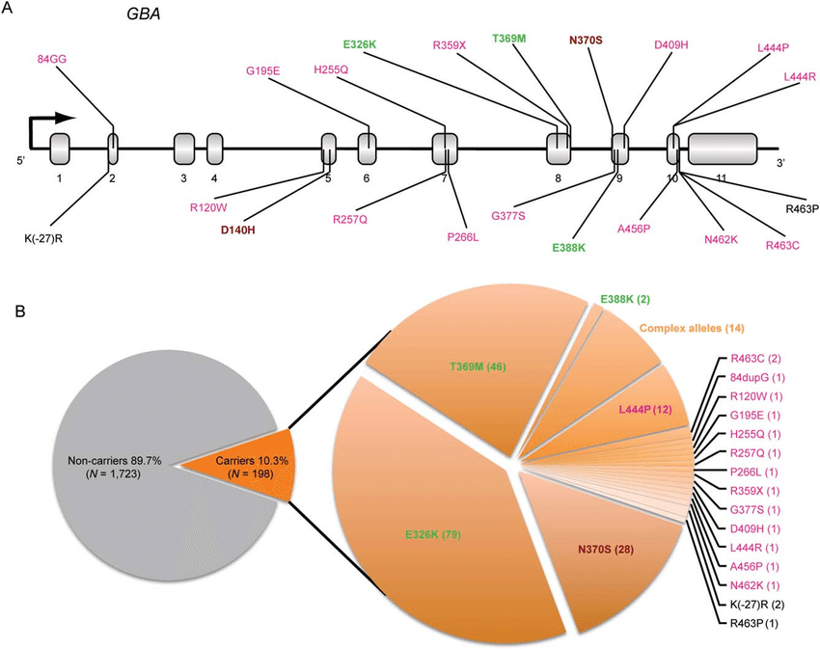

Facts about the gaucher genes
Gaucher disease is the most common genetic disease of Ashkenazi Jews, although the disease is found in every ethnicity.
GBA mutations are found on the first chromosome.
Hundreds of mutations have been identified as causing Gaucher disease.
People with the same genetic mutations may not have the same symptoms, even in the same families.
Illness type and progression may be difficult to predict based on genetic mutations alone, although some mutations tend to create the same symptoms in many patients.
Your Gaucher disease is generally unique to you.

Slide 7
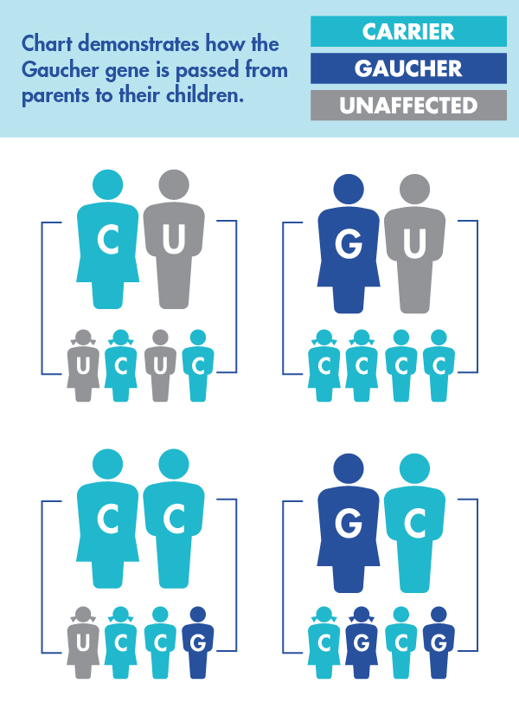
How the Gaucher gene is passed down from parents to children
Gaucher disease is an AUTOSOMAL RECESSIVE rare disease. Autosomal means the mutation does not occur on the chromosomes ( X or Y) that determine sex. It means that being male or female has no influence on whether the gene is passed down and can affect either sex.
Recessive means that the gene is weaker than a dominant gene and requires both parents to give the child a recessive gene in order to have the disease. Dominant genes will generally express themselves over recessive.
The chart shows the risk for a child born to parents FOR EACH PREGNANCY.

Slide 8
Types of Gaucher disease
There are 3 types of Gaucher disease. Many researchers and physicians posit that the types are on a continuum rather than 3 distinct types.
The traditional way of describing distinct types are
Type 1- no neurological progression
Type 2- neurological symptoms that progress rapidly, leading to early death.
Type 3- neurological symptoms that develop over time and progress more slowly than Type 2.
The relationship between Type 1 and Parkinson’s disease and the longevity of some nGD patients have brought new ways of thinking about how the types express throughout the community.

Slide 9
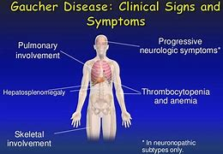
Symptoms of gaucher disease

Slide 10
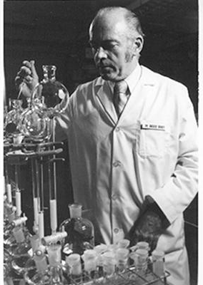
Dr. Roscoe Brady’s Early gaucher disease research
In the 1960s Dr. Roscoe Brady began research on Gaucher Disease in the NINDS at NIH.
In 1964 Brady discovered the biochemical defect in Gaucher disease, and posited that enzyme replacement therapy, a concept de Duve introduced in 1963, could be a possible treatment. He published his finding in Pediatrics, Vol.34 No.4 October,1964,
In 1967 Brady found that glucocerebrosidase was localized in lysosomes.

Slide 11
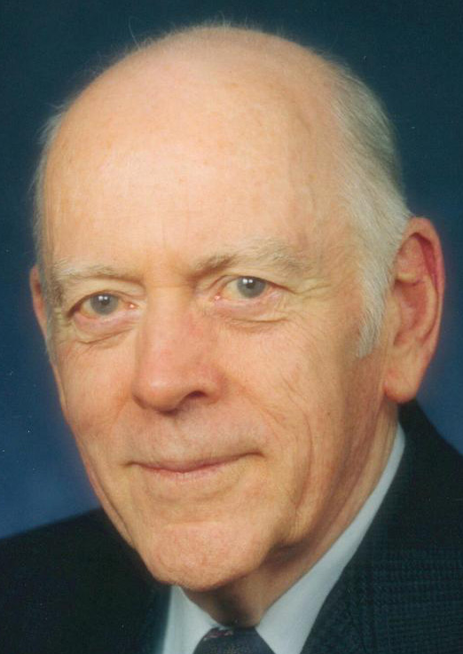
The first trials of Enzyme replacement therapy For Gaucher disease
In the early 1970s Brady and his colleagues isolated glucocerebrosidase in human placenta and purified a small sample to begin a small human trial in patients. At that time, Gaucher patients were being followed longitudinally at the NIH for symptom progression.
Although there were larger samples made and more patients tested with ERT by 1976, the results were not what they had expected. The enzyme did not uptake in the macrophages as needed.

Slide 12
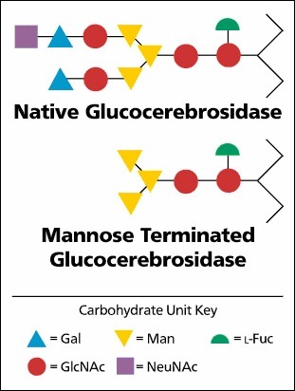
Mannose Terminated Glucocerebrosidease
After the original glucocerebrosidase did not result in clinical responses as hoped, research indicated that terminating the enzyme with a mannose molecule resulted in the enzyme staying in the cells longer, and therefore breaking down more of the stored substances.
With that modification, it was ready for a human trial.

Slide 13
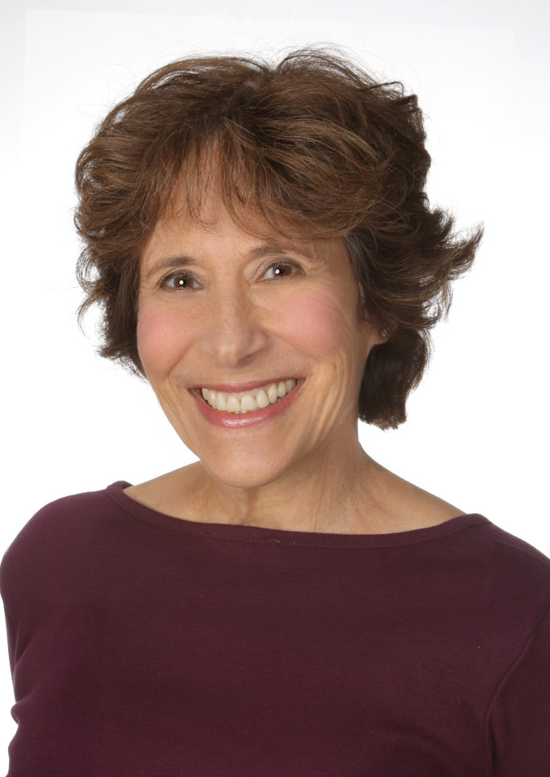
Dr. Robin ely and the bermans found the national Gaucher foundation
Dr. Robin Ely is a physician who began working with Dr. Brady at NIH assisting him in finding a treatment for Gaucher disease.
Dr. Ely and her family created the National Gaucher Foundation in 1984 to provide information to the Gaucher Community, to test possible carriers and patients, to assist patients in making good healthcare choices, to advocate for treatment and a cure, and fund and disseminate research, medical care , and educational opportunities throughout the Community.

Slide 14
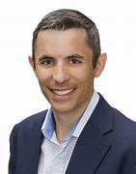
Brian Berman and the Clinical Trial Response
As a young child, Brian was the first person treated with mannose –terminated glucocerebrosidase at the NIH. His responses to ERT demonstrated great improvement in his symptoms in a short period of time, particularly in his energy level, blood levels, and reduction of spleen and liver sizes.
His positive response allowed the clinical trials to move forward, first to establish optimum dosage/kg weight, and then efficacy trials for FDA approval.
Brian has been President and CEO of the National Gaucher Foundation since 2012, and is also a partner of Berman Enterprises.

Slide 15
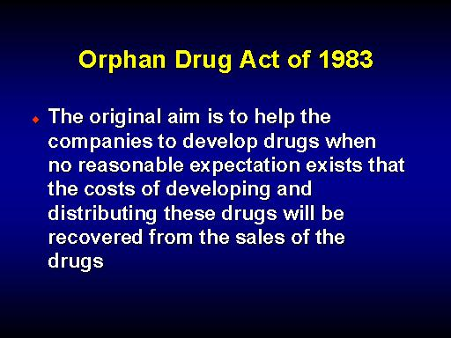
The orphan drug act of 1983
Gaucher disease is an orphan disease. This means that it affects less than 200,000 nationwide.
In January 1983, the first Orphan Drug Act was approved to give financial incentives to biotech companies to develop treatments for rare or orphan diseases. This act has been renewed and amended several times.
The passing of the Orphan Drug Act of 1983 opened the door for the mass production of Ceredase by Genzyme Corporation.

Slide 16

Henri Termeer creates Genzyme biotech
The Orphan Drug Act of 1983 allowed a large-scale production of ERT to be made. The company that was created to manufacture the drug was called Genzyme. Henri Termeer became the leader of the small biotech that would grow into an important developer and manufacturer of not only Ceredase, but Cerezyme and Cerdelga. Additionally, other recombinant treatments were perfected for other rare disorders. Eventually Genzyme created non-rare therapeutics as well.
Termeer was considered an important leader in the biotech industry throughout his life.

Slide 17
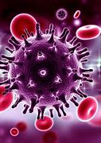
HIV prevention in the human product, ceredase
The timeline of the development of Ceredase corresponded with the time of the AIDS epidemic in the United States. Ceredase was made from human placenta that could have possibly been contaminated with HIV. It was known that HIV could not live in high temperatures; therefore the ERT was heat treated as part of the manufacturing process to assure it was HIV free.
Patients who received Ceredase were required to have HIV testing every six months during treatment.

Slide 18
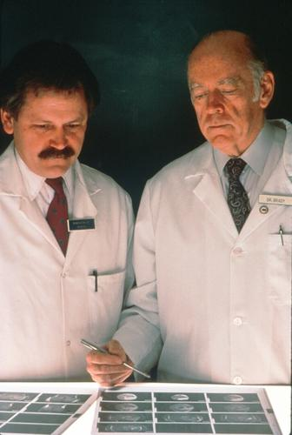
The efficacy trial to fda approve ceredase
Dr. Norman Barton led the NIH clinical trial for efficacy to receive FDA approval for Ceredase.
Twelve (four adults and eight children) Type 1 Gaucher patients of various ages participated in the trial in which all participants received 60U/kg weight every two weeks. The trial required monitoring of the volumes of their spleen and liver, their blood, and also their bones. Quality of life was also assessed.
The results showed improvement in blood parameters, serum acid phosphatase levels, and spleen and liver enlargement in all patients, and a slight skeletal improvement. Patients also reported more vigor, less fatigue, less bone pain, and a better quality of life over all. There were no adverse drug antibody developments for any of the patients.
On the basis of the clinical trial, Ceredase was given FDA approval in 1991.

Slide 19
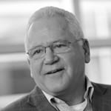
Dr. Norman Barton and shire human genetic therapies
After his tenure at NIH, Dr. Barton became the Head for Global Medical Affairs at Shire Human Genetic Therapies in 2008.
His goal was to develop an effective first-in-class therapeutics for rare disorders and underserved populations. Under his tenure, VPRIV was granted FDA approval in February, 2010.
FDA granted VPRIV Priority Review and was granted marketing approval in only six months. The approval was important to ease the lack of treatment options for Gaucher patients due to the Cerezyme shortage.

Slide 20
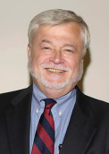
Dr. John A. Barranger
Dr. Barranger was part of the team that researched and developed enzyme replacement therapy at NIH.
An early pioneer of gene therapy, he practiced at the University of Pittsburgh Medical faculty until 2005 where he developed and directed the Human Gene Therapy Applications Lab, the Center of Study and Treatment of Jewish Genetic Diseases, and the Comprehensive Gaucher Treatment Center. He was co-director of the Human Gene Therapy Center and medical director of the Molecular Medicine Institute.
He founded the Lysosomal Storage Disease Clinical Care Network for patient care and support throughout the United States.

Slide 21
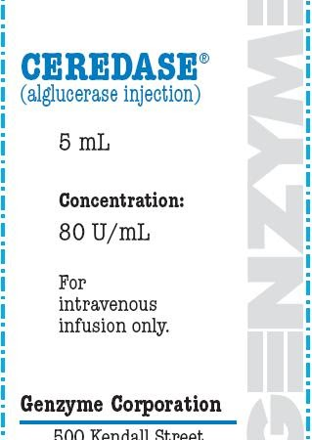
Ceredase is approved by the fda in 1991.
It is mannose-terminated glucocerebrosidase given through an IV, generally every two weeks for life.
It was the first enzyme replacement therapy approved by the FDA and the first treatment for Gaucher disease.
It was made from human placenta and was a collaborative effort by NIH and the newly formed Genzyme Corporation.
It was, at the time, the most expensive drug ever developed.

Slide 22
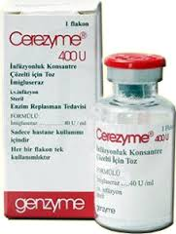
Cerezyme, the recombinant form of Ert, was approved in 1993.
The first recombinant DNA ERT, Cerezyme, was produced by Chinese Hamster Ovary (CHO) cells in bioreactors at Genzyme Corporation. It was FDA approved in 1993.
It replaced the human product Ceredase as the primary ERT for all types of Gaucher disease.
Cerezyme is still prescribed today as a major prescribed drug for Gaucher disease.

Slide 23
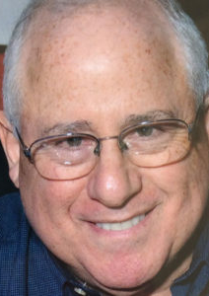
The Gaucher Disease E-mail Discussion group
In 1994 Dr. Wayne Rosenfield created an online discussion group through e-mail. It is still currently active, and gives members of the Gaucher community the opportunity to talk to each other about current issues and topics.
Hundreds of patients and interested parties have participated in the chats that cover a wide range of topics.
The group is open to all in the Gaucher community.

Slide 24
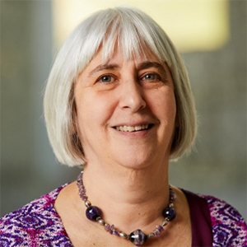
dr. Ellen sidransky and the gaucher- Parkinson’s link
Dr. Sidransky has been Chief of the Molecular Neurogenetics Section of the Medical Genetics Branch of the Human Genome Research of NIH since 2000.
She is the first to identify glucocerebrosidase as a risk factor of Parkinson’s disease. Her research includes collaborative studies of the link between Gaucher and Parkinson’s, researching the genetic aspects of Parkinson’s and Lewy body dementia, and developing small molecule chaperone therapy for Gaucher and possibly Parkinson’s patients.
She developed and currently evaluates Gaucher patients and their relatives who have GBA mutations and parkinsonism through NIH protocols.

Slide 25
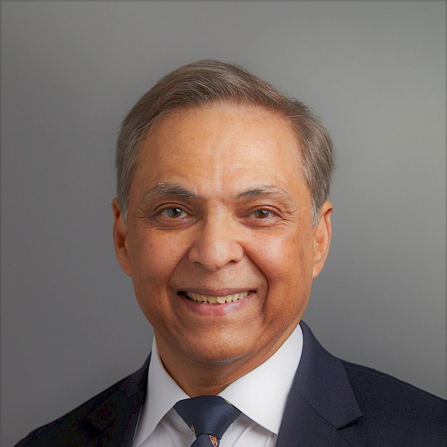
Dr. Pramod mistry, yale professor, international gaucher scholar, researcher, and Physician
Dr. Mistry has combined educational, research, and clinical practice into a world renowned medical practice at Yale University.
His research has focused in inherited metabolic liver diseases, particularly Gaucher disease.
His research includes “the first authentic conditional KO mouse model of Gaucher disease and the first GWAS/WES studies and delineation of metabolic inflammation and neuroinflammation in search for genetic modifiers of this extraordinarily diverse Mendelian disease.”
He serves on the Professional Advisory Council of the Gaucher Community Alliance, board of directors of the National Gaucher Foundation and Project Hope’s Humanitarian Program for children with Gaucher disease in under-resourced populations.

Slide 26
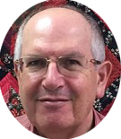
Dr. Ari zimran, researcher, and former director of the world’s largest referral centre for gaucher disease
Dr. Ari Zimran is the founder and former director of the Shaare Zedek Medical Center in Jerusalem, the world’s largest Gaucher disease referral centre.
He trained under Dr. Earnest Buetler, one of the pioneers of Gaucher disease research, at the Scripps Research Institute.
Dr. Zimran has developed and led clinical trials for all of the ERT and SRT drugs and Ambroxyl for Gaucher patients. He has edited three books and has published more than 300 articles.
Currently he is researching the relationship between Gaucher disease and Parkinson’s.
He is the Conference Chair for the 4th International Conference on Rare Disease in Vienna, Austria December 7-8, 2022.

Slide 27
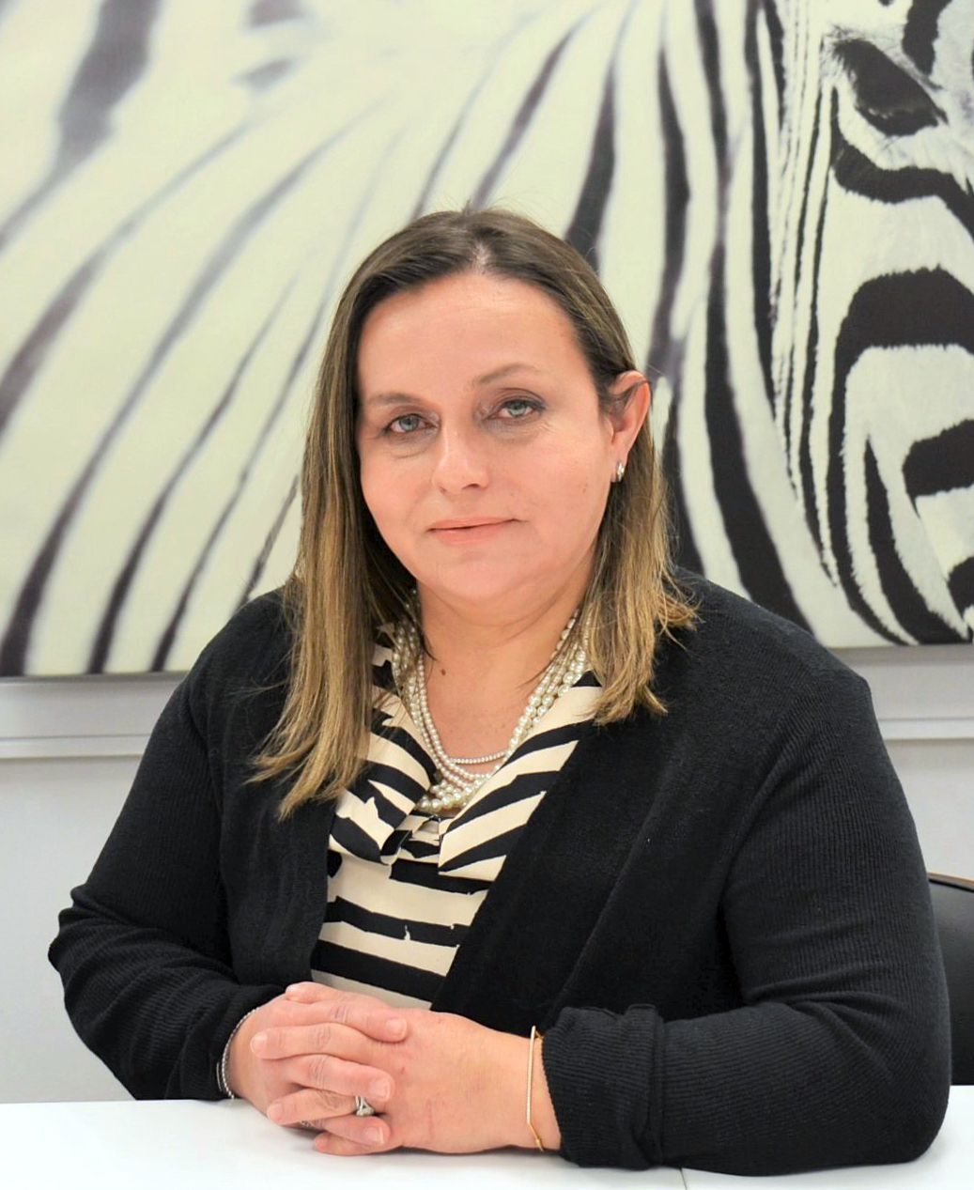
Dr. ozlem goker-alpan’s commitment to Highest quality research and care For all types of gaucher disease
Since 2013 Dr. Goker-Alpan has created a comprehensive treatment and research center, LDRTC nonprofit, to evaluate and treat patients who have Lysosomal disorders and other rare diseases.
Her clinical experience at NIH has allowed her to bring expertise to the total Gaucher population, including the often underserved nGD patients. She has “directed research on clinical immune pathways and lysosomal functions to develop new diagnostic and monitoring tools in LSDs and GBA-related Parkinsonism.”
She continues to train and educate the next generation of medical providers in Lysosomal Storage Disorders.

Slide 28
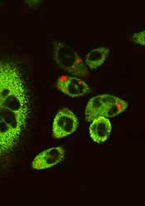
The cerezyme shortage
In 2009 a viral contamination (calicivirus of the type Vesivirus 2117) of the bioreactors that were producing Cerezyme and Fabrazyme for Fabry disease in the Genzyme Allston Landing site affected the quantity of medicine produced by the Chinese Hamster Ovary cells. The plant was shut down and decontaminated, causing Gaucher patients to not receive their treatment for six months or more. The remaining drug was rationed among the patients according to medical need.
To assist patients, a new ERT treatment from Shire, VPRIV, was granted emergency FDA approval. Not all patients were allowed access to the new drug, however, by their physicians.

Slide 29
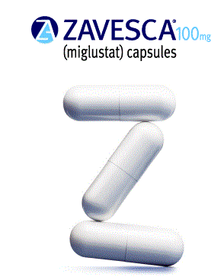
Zavesca: the first Substrate reduction (SRT)
Zavesca, manufactured by Actelion, Ltd, was approved in 2003 as the first substrate reduction therapy for Gaucher disease. SRT works differently than ERT because it reduces the amount of glycosphingolipid substrate to a level that it can be cleared by glucocerebrosidase.
It is available for mild to moderate Gaucher Type 1adult patients.

Slide 30
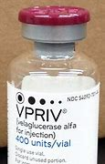
VPRIV eases the Gaucher drug shortage
VPRIV, manufactured by Shire, the second ERT approved for Gaucher disease, was approved by the FDA on February 26, 2010. The approval of VPRIV eased the lack of treatment for those who had missed their dosages during the Cerezyme shortage period. It is given at the same dosage and frequency as Cerezyme.
VPRIV uses a bioreactor one time to minimize the risk of contamination.

Slide 31
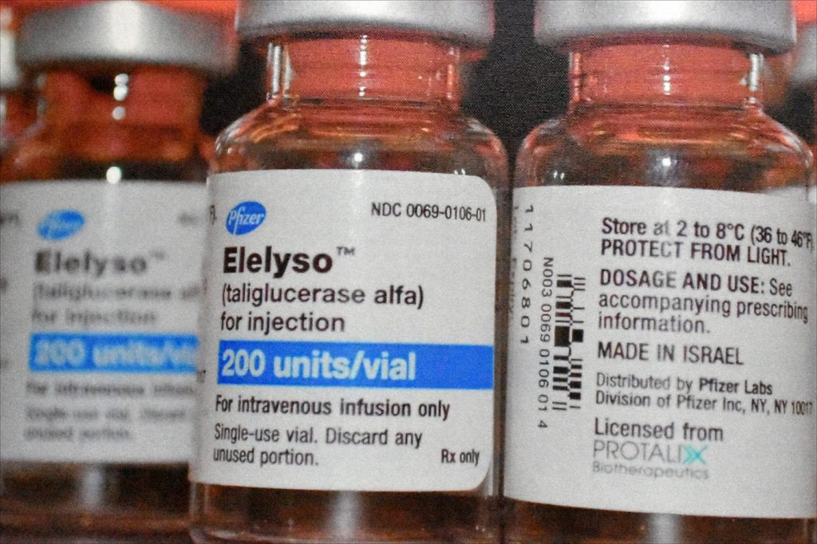
Elelsyo
Elelyso was approved in 2012 as an ERT infusion.
It is created in carrot cells and is the first plant based ERT.
It is the first OU certified Kosher prescription drug.
It is made by Protalix Biotherapeutics in Israel using the ProCelEx expression system.
It is made in 800L disposable bioreactors for added safety.

Slide 32
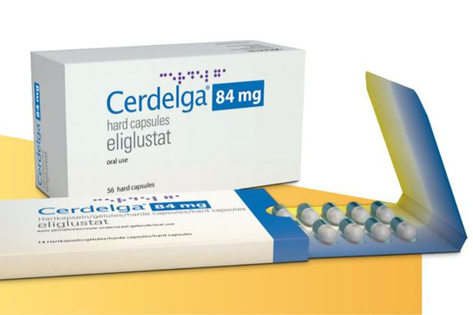
Cerdelga
Cerdelga is an oral long-term substrate reduction treatment for Type 1 Gaucher disease.
Cerdelga dosage is based on the CYP2D6 metabolic status of the patient. CYP2D6 is an enzyme that plays a role in breaking down certain drugs. A genetic test determines the patient’s status, and whether they can be treated with Cerdelga and at what dosage (one or two capsules a day).
Cerdelga has been shown to decrease symptoms in most patients similarly to ERT.

Slide 33
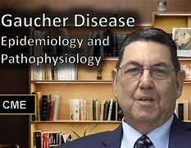
Dr. Neal Weinreb and the Icgg gaucher registry
In 1991-92 as one of the FDA mandates for tracking efficacy of Ceredase, eight Gaucher specialists enrolled 16 patients into a registry that would become invaluable to the entire Community for many years to come.
Because the U. S. did not have a centralized medical program for rare disease, it was difficult for many patients to find an experienced Gaucher specialist in their community.
The data in the Registry has been invaluable for tracking symptoms and providing at hand data for research worldwide.
After the passing of Dr. John Barranger, Eric Rice and Michelle Hackenberry created Data Registry Services, LLC to insure that patients worldwide could be included in this invaluable service.

Slide 34
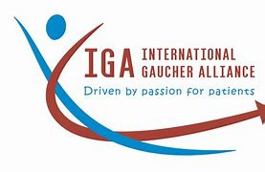
International gaucher alliance
The International Gaucher Alliance supports Gaucher patients and organizations world wide.
The Strategic Plan for the IGA from 2021 to 2023:
The IGA’s Strategic imperatives seek to achieve a strong voice for Gaucher patients through collaboration and partnership.
Improve Gaucher patients’ access to optimal diagnosis, treatment and care
Influence the Gaucher research agenda so it’s focused on addressing key unmet needs
Support member organizations to be more effective and sustainable

Slide 35
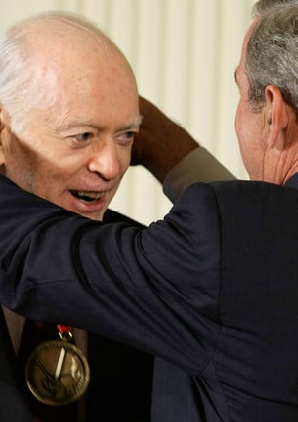
Dr. Brady receives the National Medal of technology and innovation medal, 2008
In 2008, Dr. Roscoe Brady received the National Medal of Technology and Innovation from President George W. Bush.
“For the discovery of the enzymatic defects in hereditary metabolic disorders such as Gaucher disease, Niemann-Pick disease, Fabry disease and Tay-Sachs disease, devising widely used genetic counseling procedures and development of highly effective enzyme replacement therapy that provided the foundation for patient treatment, and for stimulating the creation of and fostering the success of many biotechnology companies that now produce the therapeutics for the treatment of the diseases.”

Slide 36

Gaucher disease and Parkinson’s disease Clinical trials
The Michael J. Fox Foundation is conducting research with adults who have GBA (Gaucher) mutations, both carriers and patients.
There is an important link between GBA mutations and developing Parkinson’s disease.
If you have a GBA mutation (or two) and would like to participate in a clinical trial, this website will give you all the information you need.
“PPMI: The Study that Could Change Everything”
https://www.michaeljfox.org

Slide 37
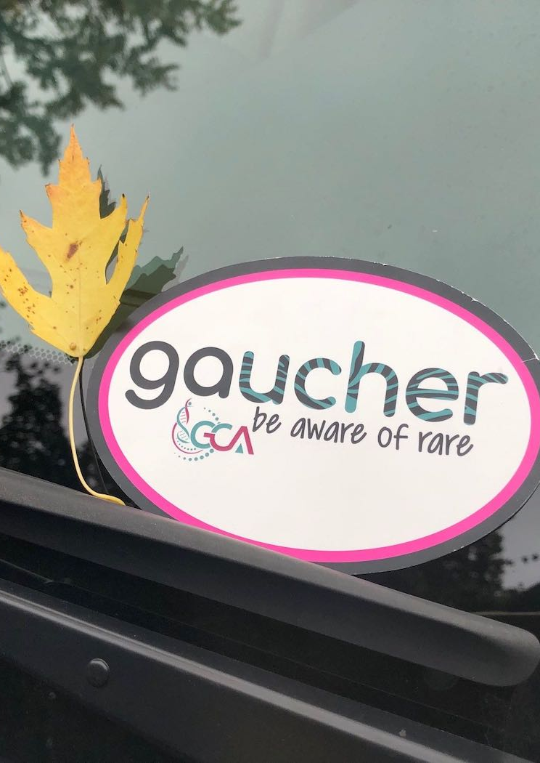
Gaucher community alliance
Gaucher Community Alliance is a (501)(c))(3) non-profit created by patients for patients to support and advocate for Gaucher patients of all types and their families.
The mission of the GCA is to ”to help those affected with all types of Gaucher disease live their fullest life possible.” The GCA supports patients and their families through peer-to-peer support and education, advocacy, patient and family resources, and networking. They hope to ensure that no families shall face this disease alone.

Slide 38
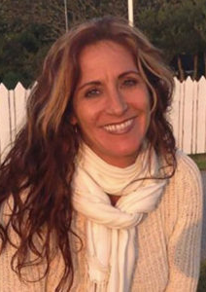
Gaucher Community Alliance Co-president Cyndi Frank
Cyndi Frank is the co-founder and co-president of the Gaucher Community Alliance. As a Gaucher patient, she has advocated tirelessly for patient support while participating in clinical trials to approve treatments and increase understanding of Gaucher disease.
Cyndi has spent her professional life advocating for Gaucher patients through:
Working for the National Gaucher Foundation as a fundraiser and patient advocate
Working at a biotech
Advisory roles in boards, committees, drug companies., and rare disease organizations

Slide 39
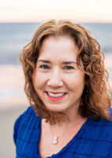
Gaucher Community Alliance co-president aviva Rosenberg
Aviva Rosenberg, JD, is co-founder and co-president of the Gaucher Community Alliance. As a patient and parent of a child with Gaucher disease, she has worked tirelessly to shorten the journey between the first symptoms to diagnosis.
Her professional and advocacy life include being :
A health-care attorney
An adjunct professor
An educator of rare diseases, advocate for genetic testing, insurance access, coverage, and appeals, and genetic screening
-

Slide 40
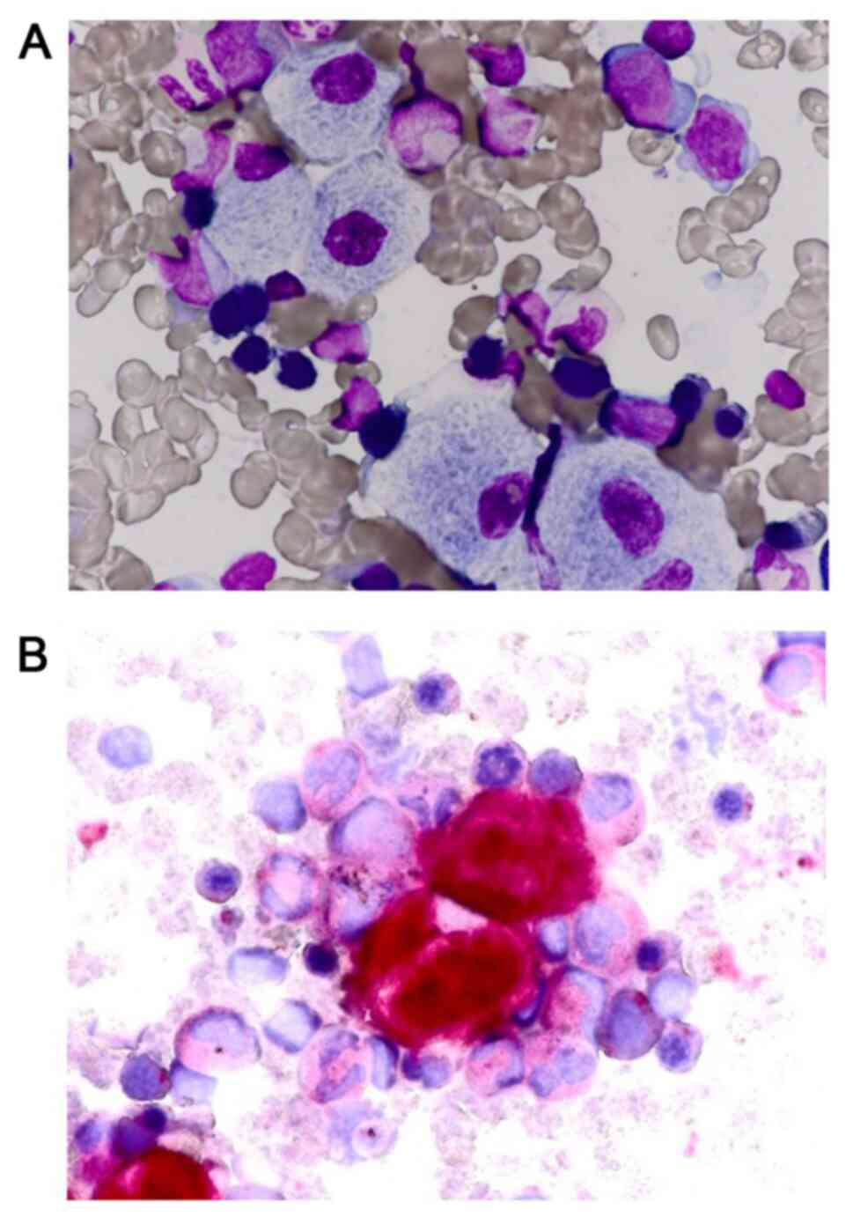
Gene therapy trials
Gene therapy provides a long-awaited cure for Gaucher disease because it replaces the defective gene in the body with healthy genes that can then reproduce and create additional healthy cells.
There are two types of gene therapy:
Gene Editing- the removing of defective parts of the gene sequence and replacing them with corrected version (a cut and paste)
Gene Augmentation – an addition of a functional copy of a gene that allows the cell to function as a healthy cell. This has been researched for 30 years under FDA approvals.
There are currently several clinical trials under way in early stages for gene therapy for Gaucher disease.

Slide 41
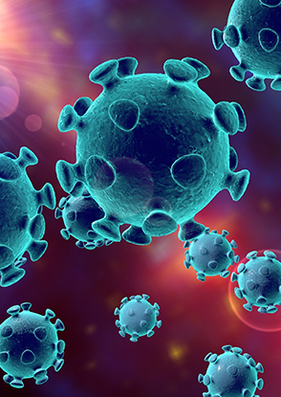
Gaucher disease response to Covid-19
Throughout the Covid 19 Pandemic, the Gaucher community has received constant guidance through renowned Gaucher specialists’ communications to the groups and organizations that serve Gaucher patients.
The Gaucher Community Alliance, as well as other organizations, have shared directives, webinars and updates directing patients and their families about immunological responses, quarantine requirements, treatments for Gaucher patients with Covid, and vaccine information and recommendations. As guidelines have changed throughout the pandemic, the Gaucher community has been kept informed of changes that would optimize their safety and health.

Slide 42
Works Cited
Alglucerase Injection (Ceredase) https://www.ninds.nih.gov/about_ninds/impact/ninds-cntributions-approved therapies/alglucerase-injection-ceredaser-gaucher-disease
Barranger. John A. “ Clinicall Trial of Gene Therapy for Gaucher Disease” University of Pittsburgh
Barton, Norman W., et. al., “Replacement Therapy for Inherited Enzyme Deficiency- Macrophage- Targeted Glucocerebrosidase For Gaucher’s Disease, New England Journal of Medicine 324:1464-1470 (May 23), 1991.
Cerdelga (eliglustat) Capsules www.cerdelga.com.
Elelyso https://protalx.com/about/elelyso
Gaucher Community Alliance https://www.gauchercommunity.org
The International Gaucher Alliance https://gaucheralliance.org
The Michael J. Fox Foundation for Parkinson’s Research https://www.michaeljfox.org
National Gaucher Foundation https://www.gaucherdisease.org
Protalix. Elelyso for Gaucher Disease https://protalix.com/about/elelyso
Zavesca http://www.zavesca.com

